Slide 1

Optimization of Ventilators for COVID-19 Patients

Slide 2
Problem
The total number of COVID-19 cases recorded worldwide till date is ~4.5 million with an increasing death rate.
Our project deals with optimizing the use of ventilators based on the patient’s age as hospitals have a limited number of ventilators.

Slide 3
Problem Significance
This problem is of utmost importance as the world is facing a disastrous pandemic which is getting out of control day by day.
At this point of the outbreak hospitals are facing problems regarding ventilators as there is a limited number of ventilators. Hospitals can make use of our optimization.
Giving preference to a younger generation.

Slide 4
Current Solution
Currently, the COVID-19 critically ill patients who need ventilators are provided on first come first serve basis.
But they don’t take into consideration on how critical the patients are and the immortality rate for patients based on the age group.
And, the survival rate differs within age groups based on the ventilators provided.

Slide 5
Optimization approach
Our optimization focuses on optimizing the patient’s age to obtain maximum Quality-adjusted life year (QALY).
A patient with higher Quality-adjusted life year (QALY) will be provided with a Ventilator.
We have assumed all the patients are critical.
Number of Ventilators available in a hospital is another constraint.
We have also taken into consideration on how survival rate differs with providing ventilators in different age groups.

Slide 6
Optimization Solution
We will be using Penalty Method for optimization.
Collecting data on new COVID-19 cases using https://covid19api.io/api/v1/ReportsByCountries/US API. After which the patient’s data is sorted based on age group and provided with Ventilators.
Output will be the ventilators to be provided for patients based on the age group.

Slide 7
Risks
Providing ventilators based on age may not be ethical.
No data is found and errors in the data.
Since our model depends on the real time data, if there is a delay in the updating of new cases, it may be lethal.

Slide 8
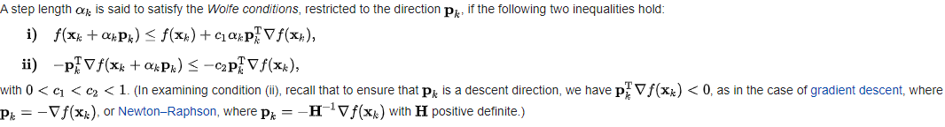
Implementation
We used penalty function to optimize , satisfying Armijo rule and curvature.
Armijo rule and curvature:
Since our optimization is to maximize the life years, we used the negative of the function to find minimum and then apply absolute to the final value.
These are the following constraints we applied:
All the ventilators should be positive.
Total number of ventilators is less than or equal to the ventilators available.
At the time of running our program, the number of active cases in the US were 247868. And we tested our model with providing 100000 ventilators.

Slide 9
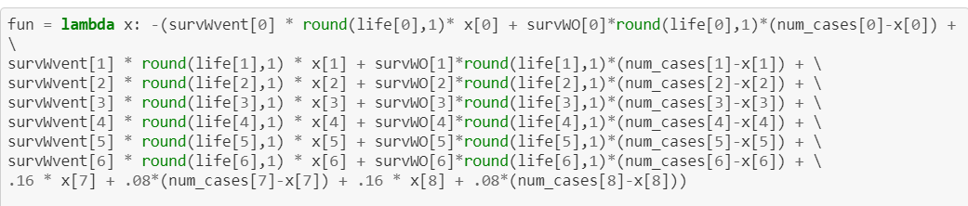
Implementation
Function:
Where, life[n] is the life years left for an age group if they survive.
Num_cases[n] is the number of cases for an age group.
survWvent[n] is the percentage of people survived on ventilators based on age group. Similarly, survWO[n].
Initialization values:
X0 = [-1, 0, 0, 0, 0, 0, 0, 0, 0]
C0 = 0.5
Multiplication factor (beta) = 2

Slide 10
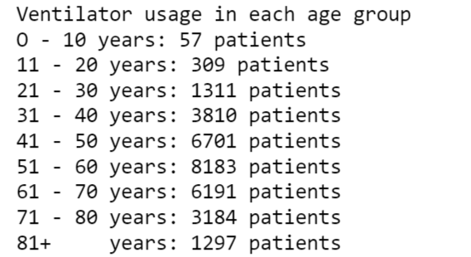
Results
The result below shows current life years expected upon random selection of patients using a normal distribution to emulate ‘first come first serve’ policy: 2215082

Slide 11
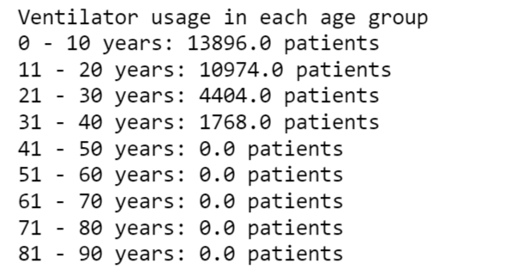
Total life years through optimization of ventilator usage using custom penalty method: 2262823.
By optimizing ventilator usage, we were able to increase expected life years by 547741.
It took the model 20 iteration to reach threshold penalty value of 0.004.

Slide 12
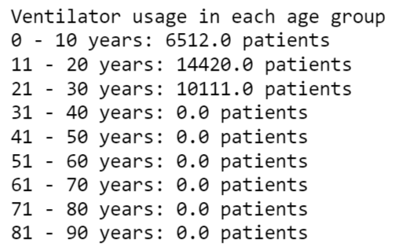
Total life years through optimization of ventilator usage using pulp library: 2717742
By optimizing ventilator usage, we were able to increase expected life years by 502660

Slide 13
Conclusion:
By optimizing the ventilators we are able to increase the saved life years
by 547741.
Our custom model of penalty method has performed better than the pre-written
pulp library in optimizing the function.
To save more lives, it is advised to provide ventilators to patients based on the
mortality rate rather than first come first serve basis.

Slide 14
Project Schedule
Week 1 : Gathering new COVID-19 cases data and equation formulation
Week 2: Problem solution and Software Implementation.

Slide 15
Collaboration
We collaborated through zoom meetings, conference calls and GitHub.
Github link:
https://github.com/csash7/ventilator_optimization

